Slide 1
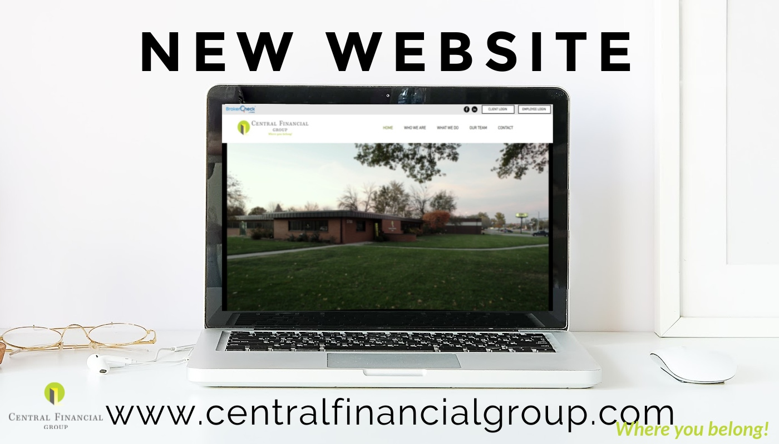
Central Financial Group
CFG Agent Digital Marketing Package

Slide 2
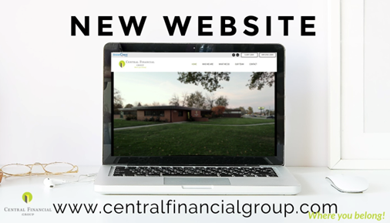
Marketing and Digital Footprint For Central Financial Group
Central Financial Group Corporate
SEO w/GEO Iowa * Blog * Social Media * Podcast * Google Search/Google Console Listing Builder * ADA Compliant * Reputation Management * Business App Dashboard
CFG Johnston Landing Page
CFG Fort Dodge Landing Page
CFG Algona Landing Page
SEO w/GEO Polk Listing Builder Reputation Management Event Calendar Social Media Google Search/Google Console ADA Compliant Business App Dashboard
SEO w/GEO Webster Listing Builder Reputation Management Event Calendar Social Media Google Search/Google Console ADA Compliant Business App Dashboard
SEO w/GEO Kossuth Listing Builder Reputation Management Event Calendar Social Media Google Search/Google Console ADA Compliant Business App Dashboard

Slide 3
Marketing and Digital Footprint For Central Financial Group
Central Financial Group Corporate
CFG Johnston
CFG Fort Dodge
CFG Algona
Agents
Agents
Agents

Slide 4
One Week Of Organic Traffic – CFG Fort Dodge
Organic traffic is those visitors that land on your website from unpaid sources, aka essentially free traffic. Organic sources here include search engines like Google, Yahoo, or Bing. The brand of digital marketing that focuses on improving organic traffic is called Search Engine Optimization.

Slide 5
One Month Of Organic Traffic – CFG Fort Dodge

Slide 6
Central Financial Group - Agents ( www.centralfinancialgroup.com ) CLICK TO LEARN MORE
Digital Marketing (Required Package for Agents) $ 400.00 / month (Receive 2nd Month Free if signed up today)
Business App Dashboard (Requires initial set up one-time charge) $ 250.00 (Waived if signed up today)
A dashboard that hosts all digital marketing and services in one format and provides real-time data
Users will be set up for access and monitoring
Dashboard set up includes all digital information, links to competitors for tracking (Google Analytics, Google Search Console, etc. )
Local Business Online Toolkit
Social Marketing CLICK TO LEARN MORE - Manage all Social Digital Platforms (Google Business Profile, Facebook, Twitter, Business LinkedIn, Instagram, etc.) Provide monthly posting at least 12 times per month. Any custom content outside of the scheduled monthly calendar will need to be submitted by Noon on Fridays for the following week.
Listing Builder CLICK TO LEARN MORE - Quickly establish accurate business information on Google Business Profile, Facebook, Instagram, LinkedIn, and Twitter for no additional charge. Own your business listings and keep your customers up to date
Reputation Management CLICK TO LEARN MORE - Manage your online reputation from one place: Compile reviews from dozens of sites so you can easily see what is being said about your business online. Plus, use competitive benchmarketing to see how you stack up to the competition.
Customer Voice CLICK TO LEARN MORE - Reach out to leverage the voice of your brand champions to improve online word-of-mouth. Invite existing customers to share their experiences online so new customers know they can trust you.
Advertising Intelligence CLICK TO LEARN MORE Tracks and monitors all Digital Marketing campaigns to review ROI

Slide 7
Contact
Kinsey Lombard
kinsey@spinmarkket.com
515-571-5115
Cheryl O’Hern cheryl.ohern@spinmarkket.com
515-571-4788
10 North 10th Street, Fort Dodge, IA 50501

